Slide 1



Provide Insights to Atliq Hardwares
Domain : Consumer Goods
Created by : Balu Chelluri
Check my other reports at

Slide 2
Agenda
Context
Input data
Dashboard
Insights
Requests

Slide 3
Context
About Atliq Hardwares
Atliq Hardwares (imaginary company) is one of the leading computer hardware producers in India and well expanded in other countries with 2.2 billion revenue and 1.5 billion profit.
Problem
The company has realized the need to enhance their data analytics team by hiring multiple junior data analysts due to the lack of adequate insights for quick decision-making. The Data Analytics Director, Tony Sharma, intends to recruit candidates with both technical and soft skills.
Approach
Providing the solutions for the given requests and insights for based on the solutions
MYSQL – solutions for queries
POWER BI – Data Visualization.

Slide 4
Atliq Production Pipeline
N&S
Storage
External SSD
USB flash drive
Network
Wi fi extender
P&A
Accessories
Peripherals
Batteries
Keyboard
Mouse
Graphic card
Internal HDD
Motherboard
Processors
PC
Desktop
Notebooks
Business Laptops
Gaming Laptops
Personal Laptops
Business Desktop
Personal Desktop
We could see there are greater number of categories in P&A division.
N&S division with less categories.

Slide 5
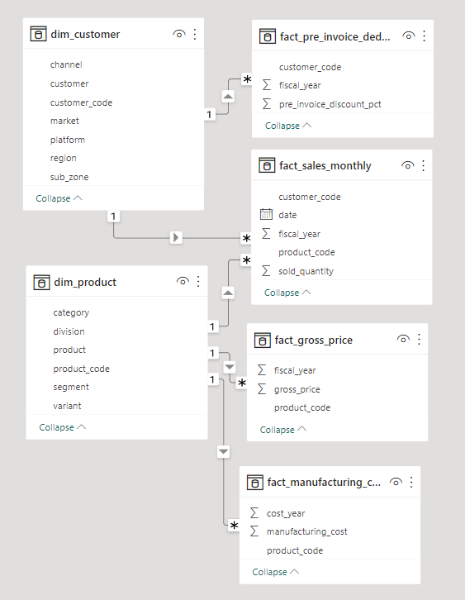
Input data
The datasets are provided by codebasics as a part of challenge.
The data was in sql format ,it is imported to MySql and connected the server to Power bi.
The Queries for the requests are solved in Mysql and Visualized in Power bi.

Slide 6
Dash Board
Click to access

Slide 7
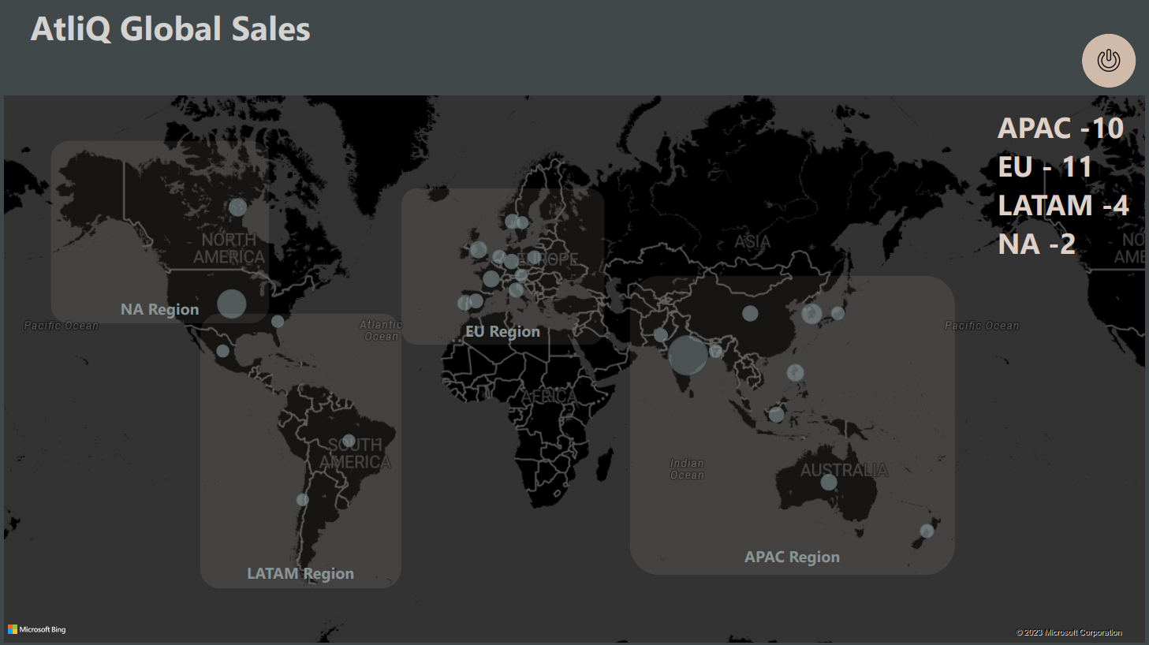

Slide 8
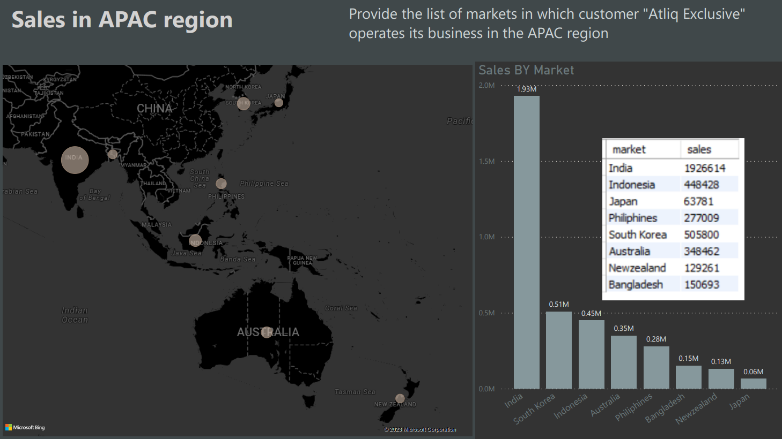

Slide 9
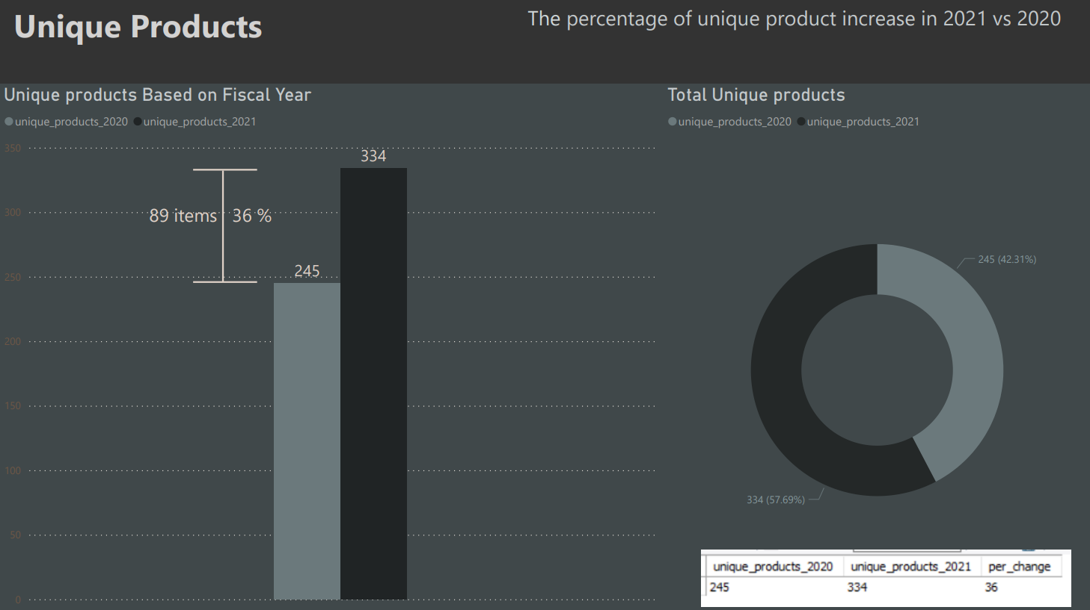

Slide 10
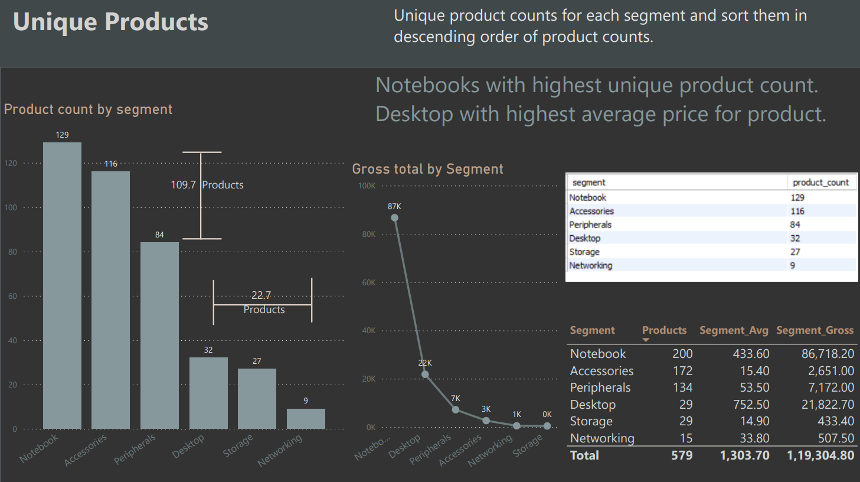

Slide 11
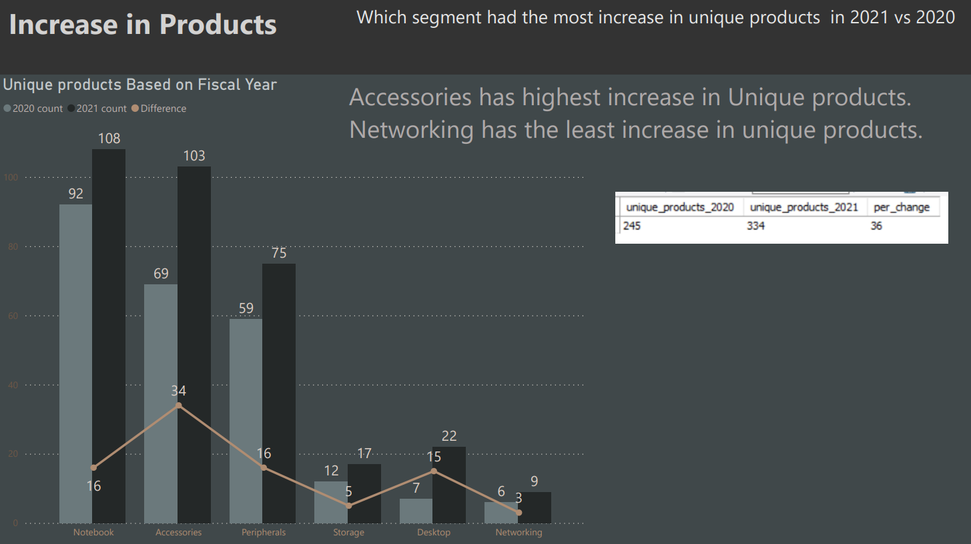

Slide 12
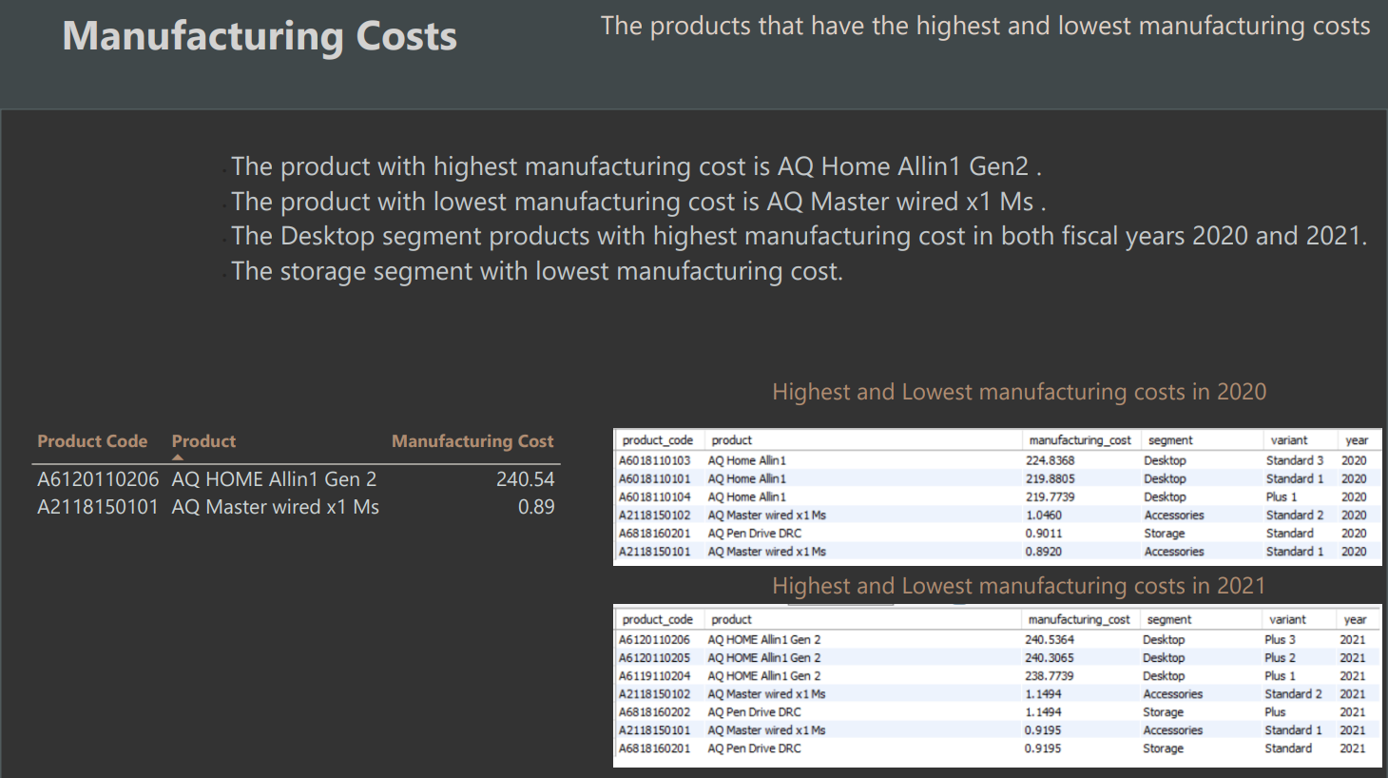

Slide 13
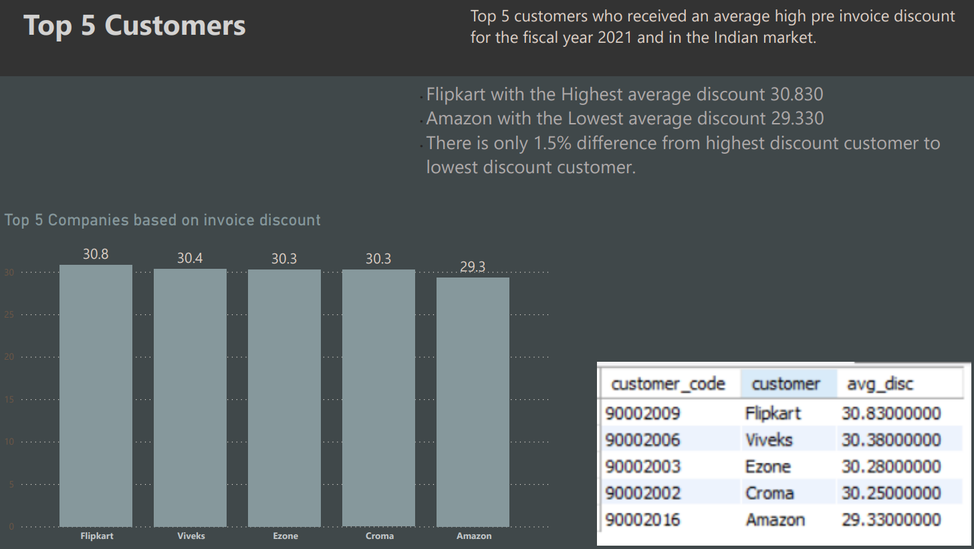

Slide 14
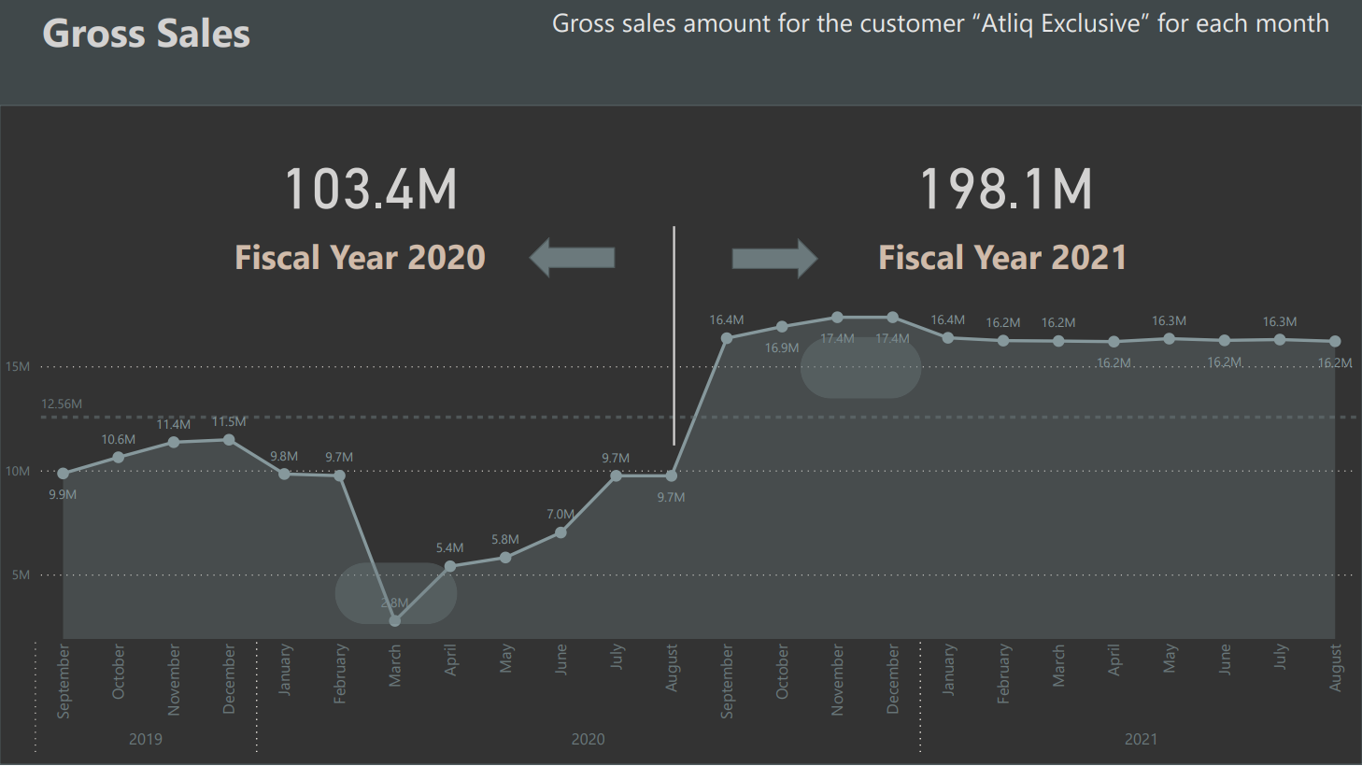

Slide 15
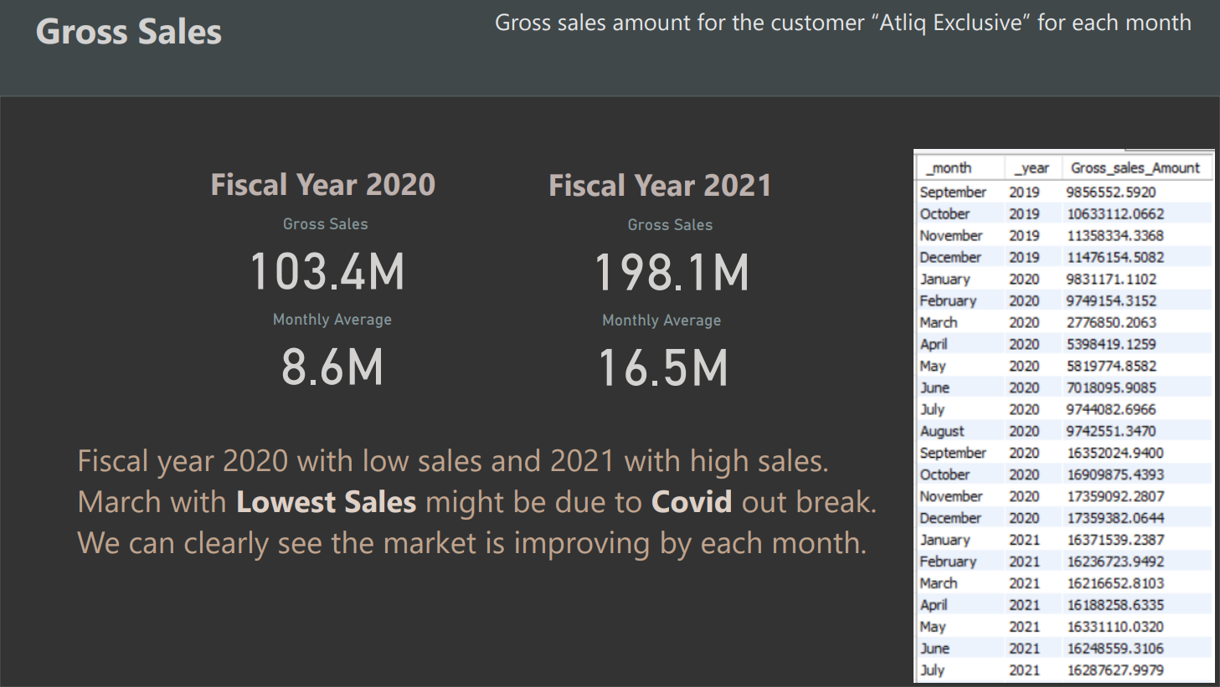

Slide 16
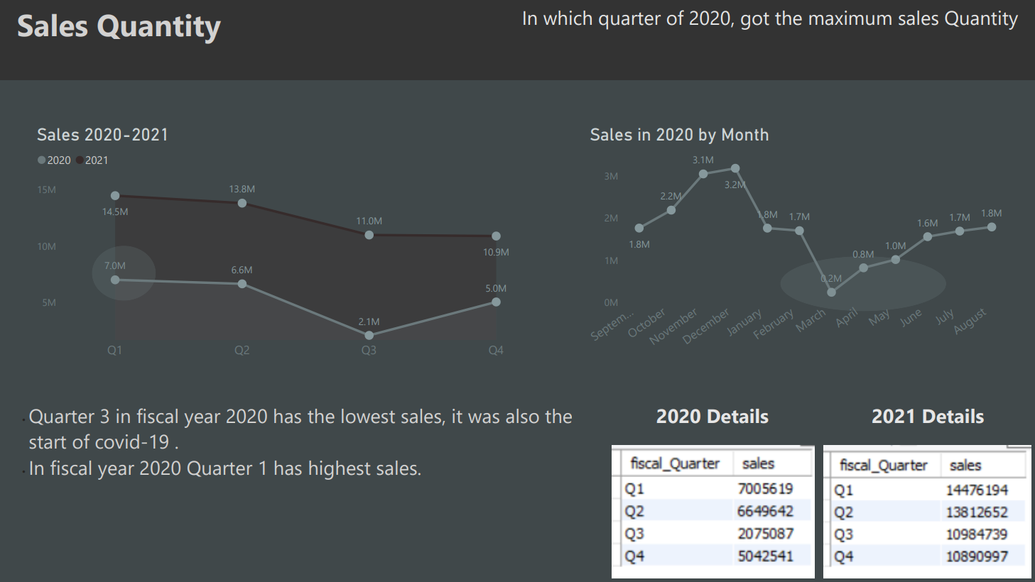

Slide 17
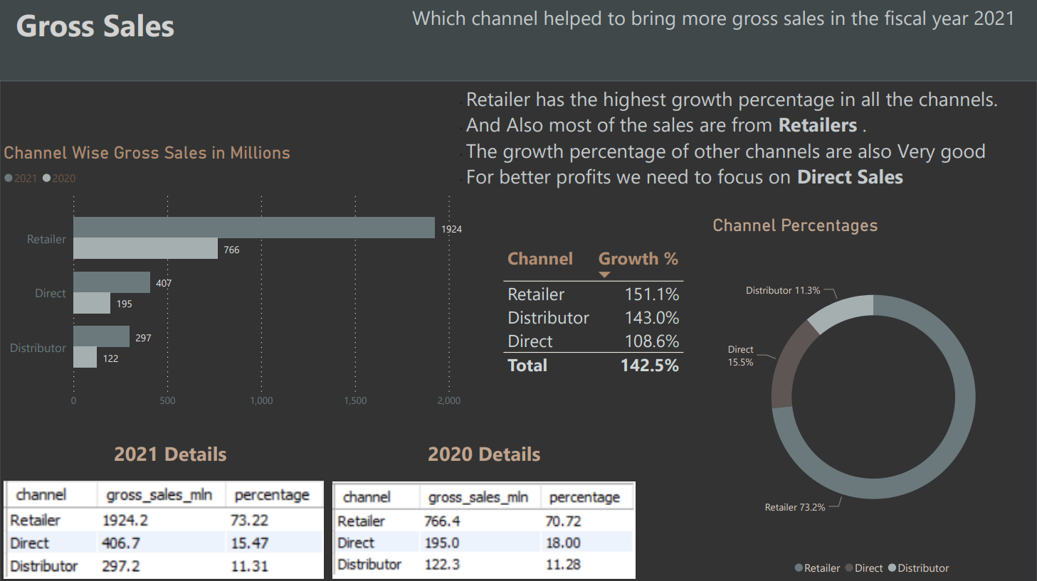

Slide 18
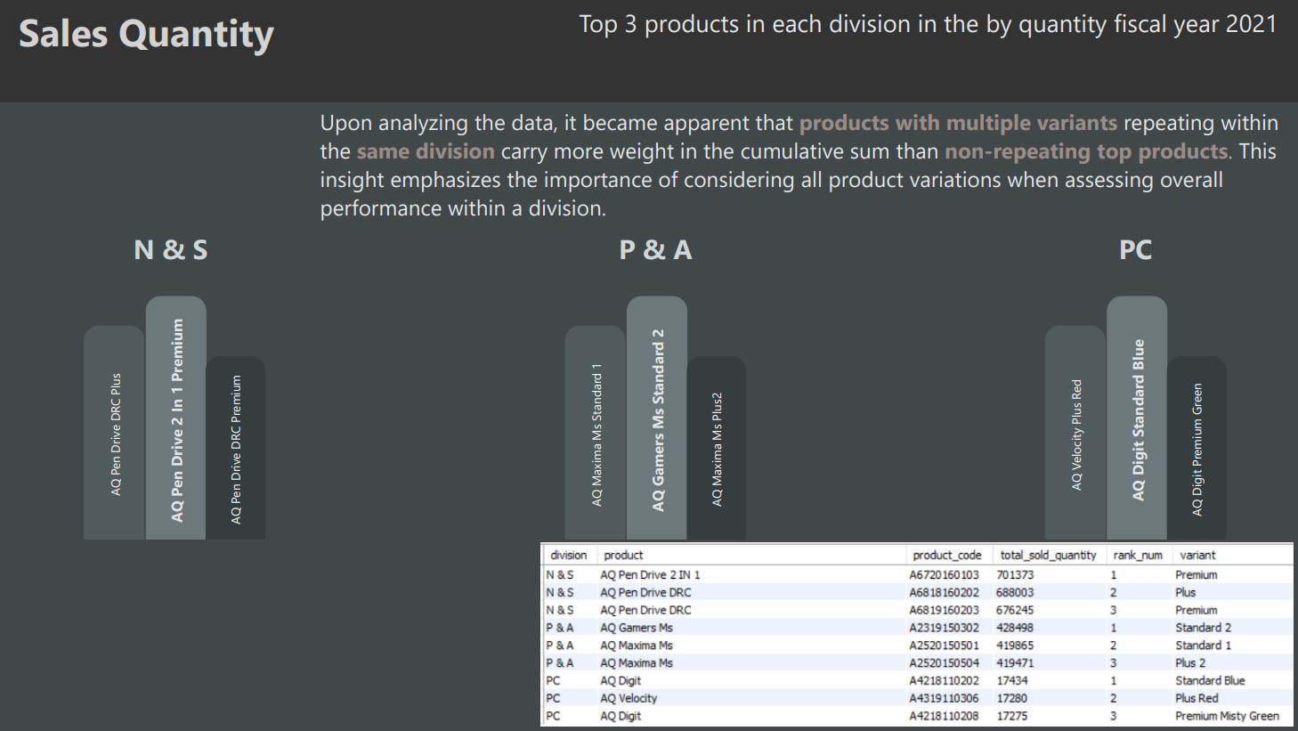

Slide 19
Thank You
Balu Chelluri

